Slide 1
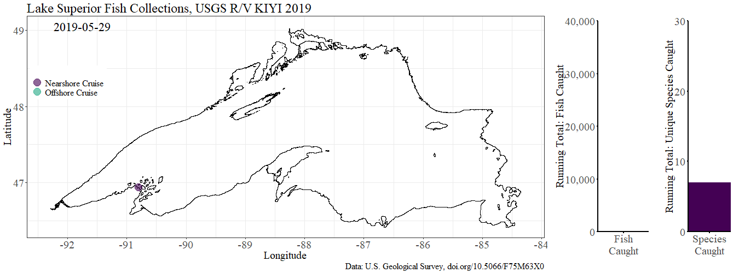
Questions for the Lake Superior
Annual Bottom Trawl Surveys
U.S. Geological Survey Lake Superior Biological Station
Ashland, Wisconsin

Slide 2
Lake Superior Prey Fish Community Objective
A self-sustaining assemblage of prey dominated by indigenous species at populations capable of supporting desired populations of predators and a managed commercial fishery

Slide 3
Status
/ stādəs / noun
Relative standing at a particular time
Trend
/ trend / noun
General direction in which something is changing
Prey Fish Status
Sustainable
Untenable
Unsure
Prey Fish Trend
Up
Down
Stable
It depends

Slide 4
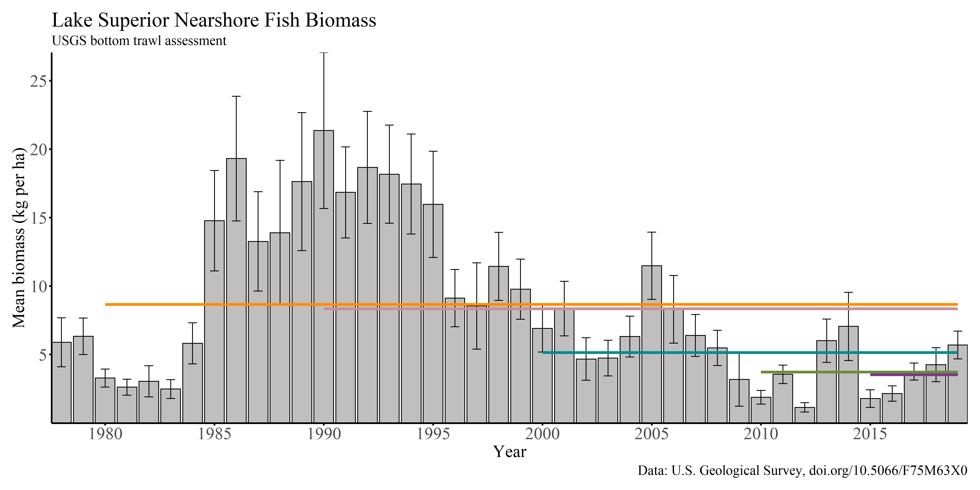
Nearshore Prey Fish Biomass
High biomass due to large Cisco year classes. As these fish aged and recruitment waned, biomass decreased.
5, 10, 20, 30, and 40
year averages
Status:
Trend: The general direction in which something is changing

Slide 5
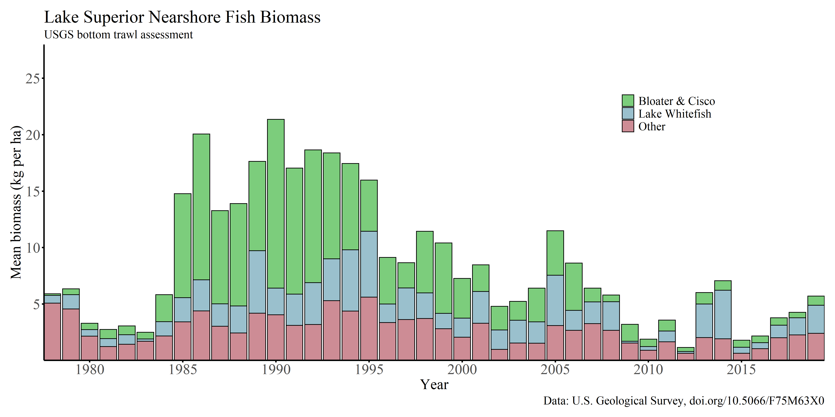
Nearshore Prey Fish Biomass
High biomass due to large Cisco year classes. As these fish aged and recruitment waned, biomass decreased.

Slide 6
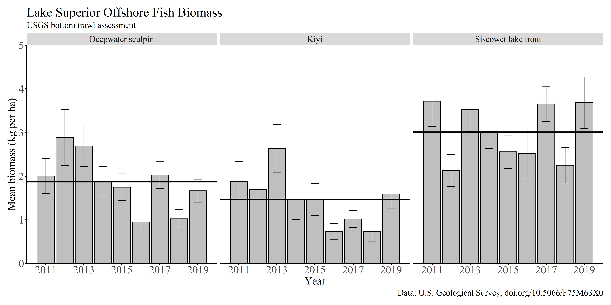
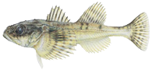
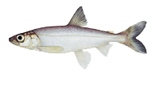
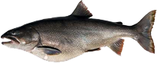
Offshore Fish Biomass

Slide 7
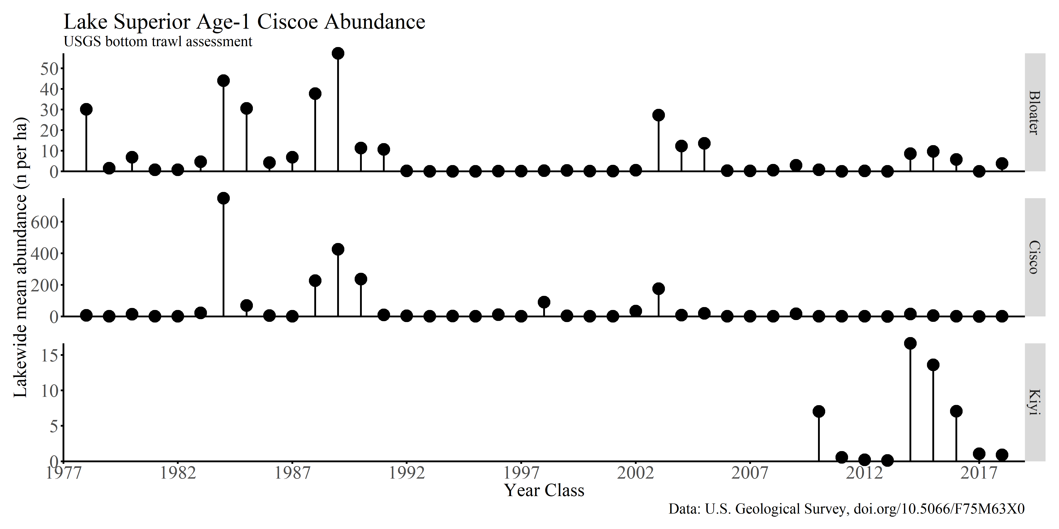
Age-1 Ciscoe Trends

Slide 8
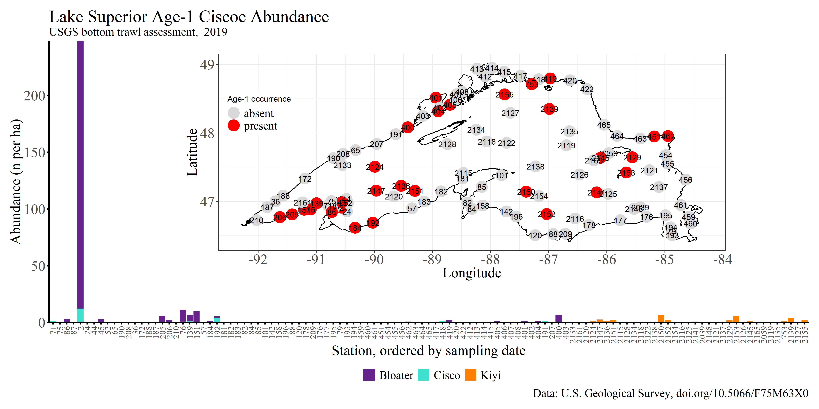
2019 Ciscoe Age-1 Collections

Slide 9
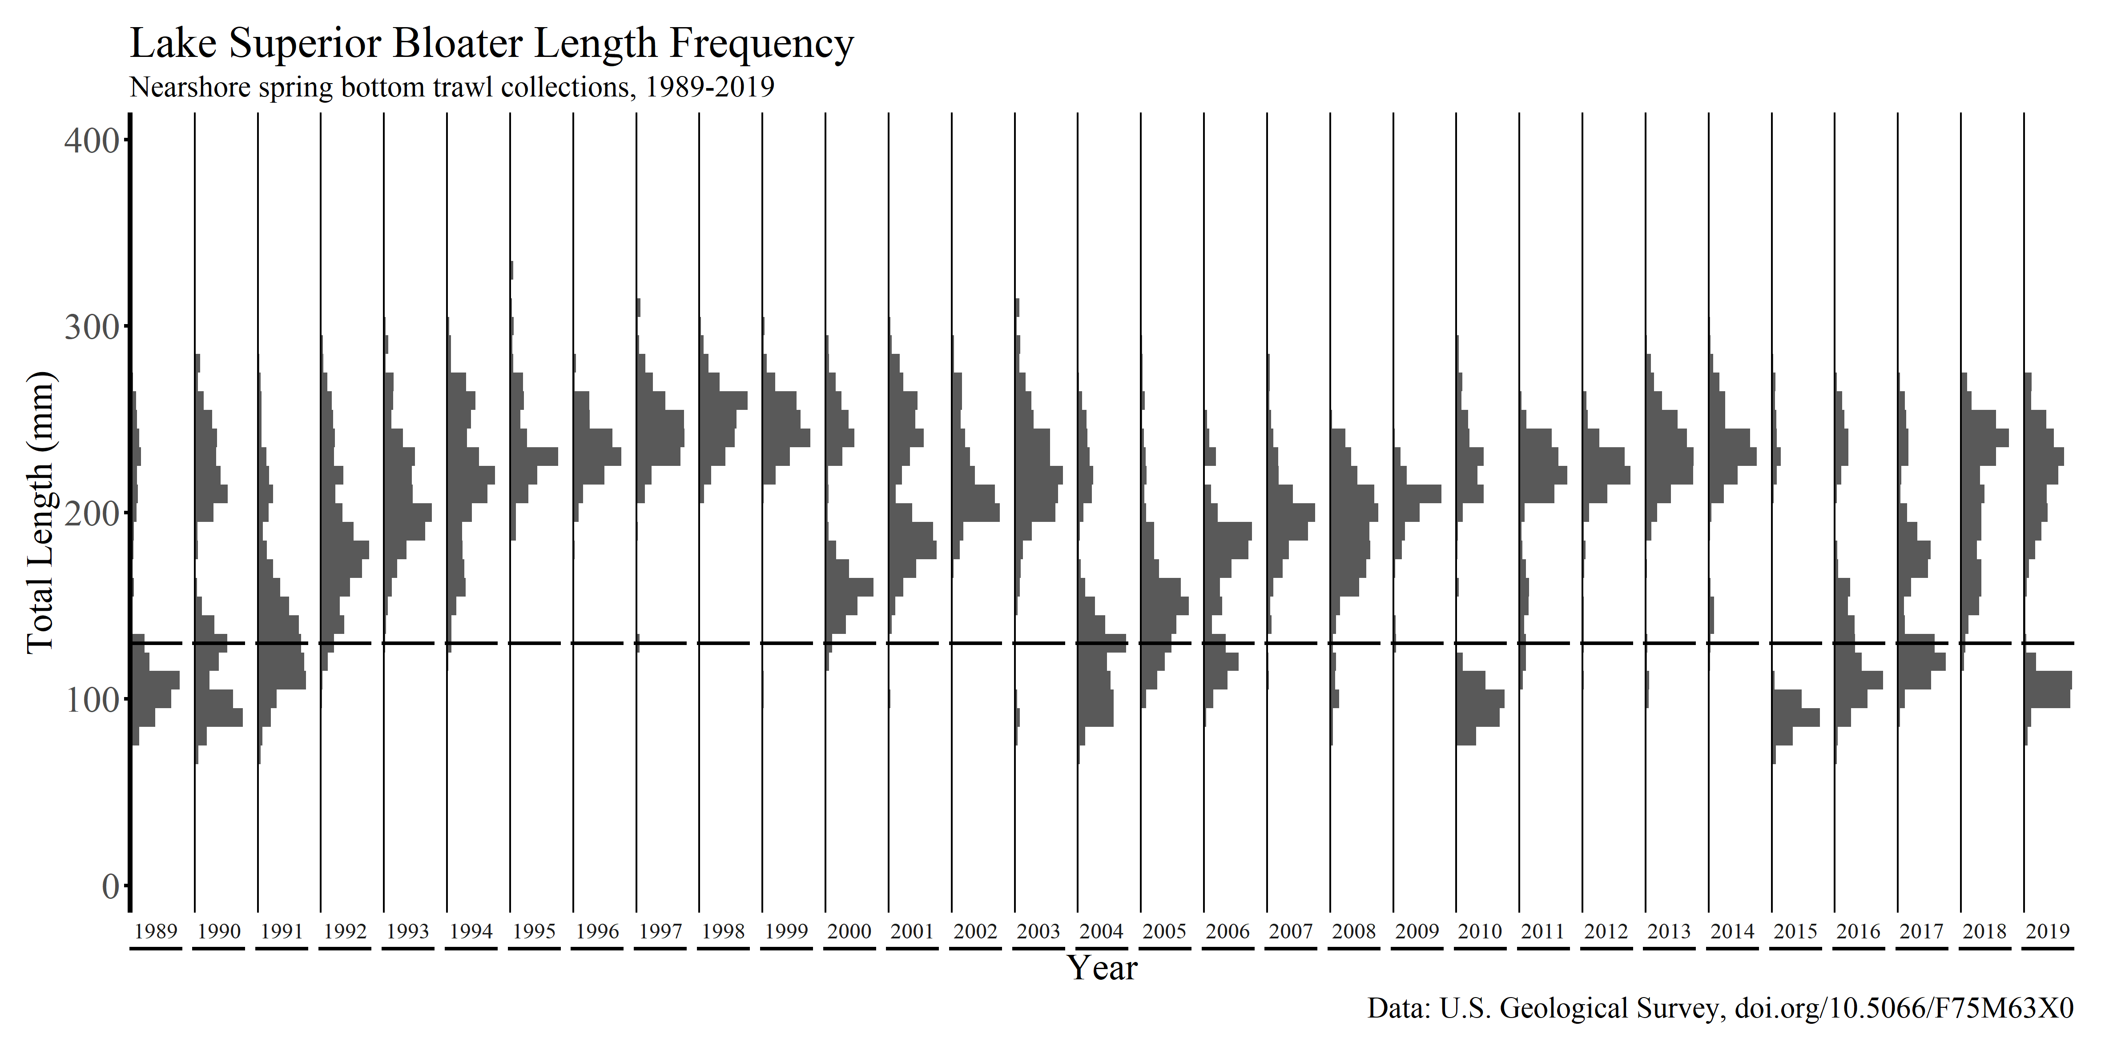
Bloater Annual Length Frequency

Slide 10
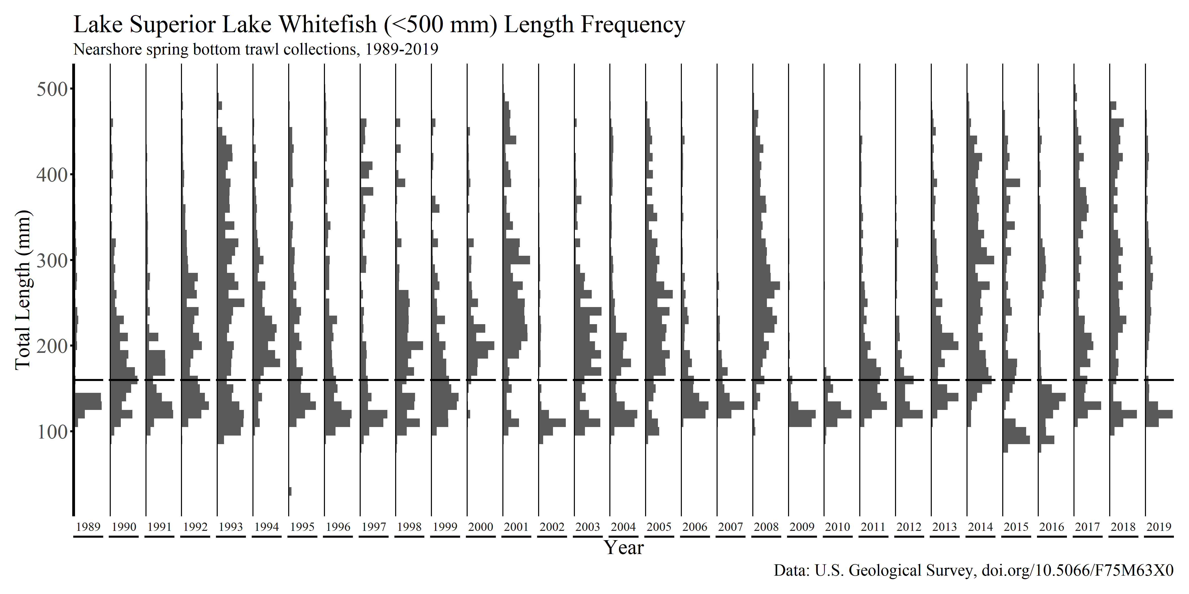
Lake Whitefish Annual Length Frequency

Slide 11
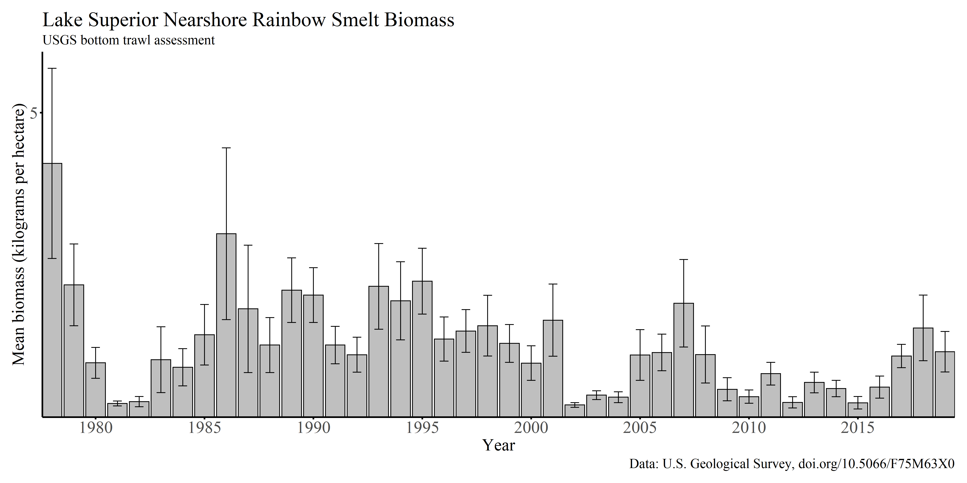
Lean Lake Trout Prey

Slide 12
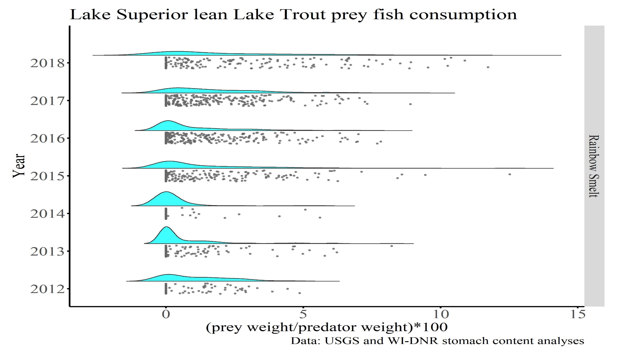
Lean Lake Trout Prey Fish Consumption

Slide 13
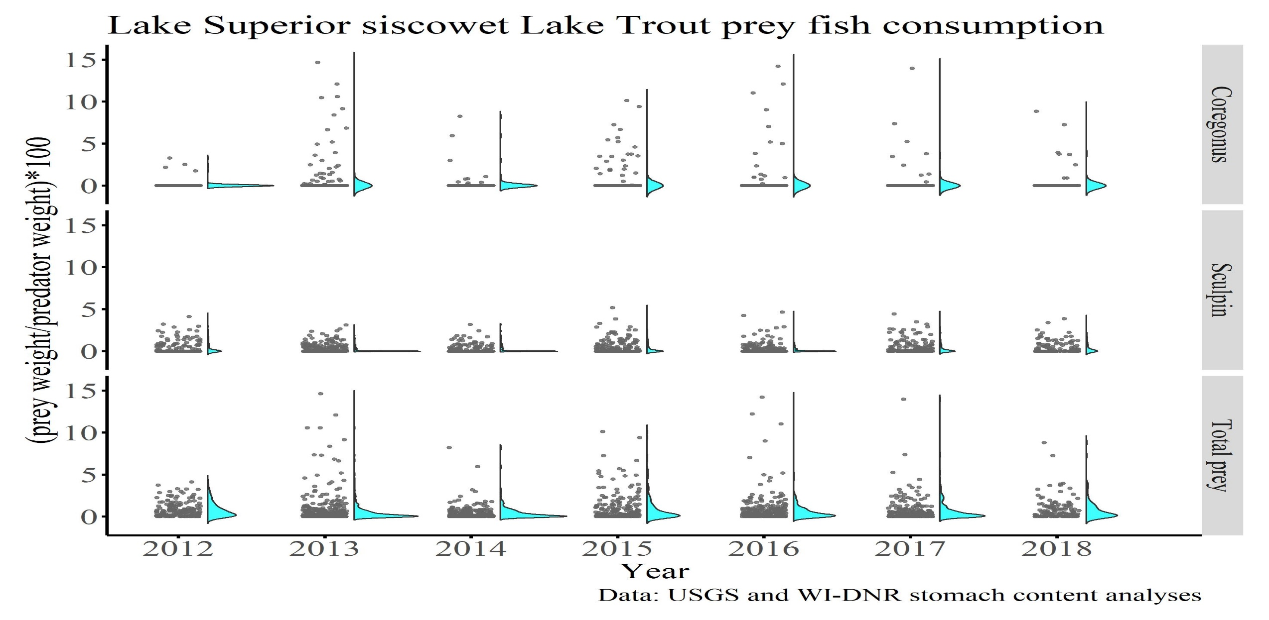
Siscowet Lake Trout Prey Fish Consumption

Slide 14
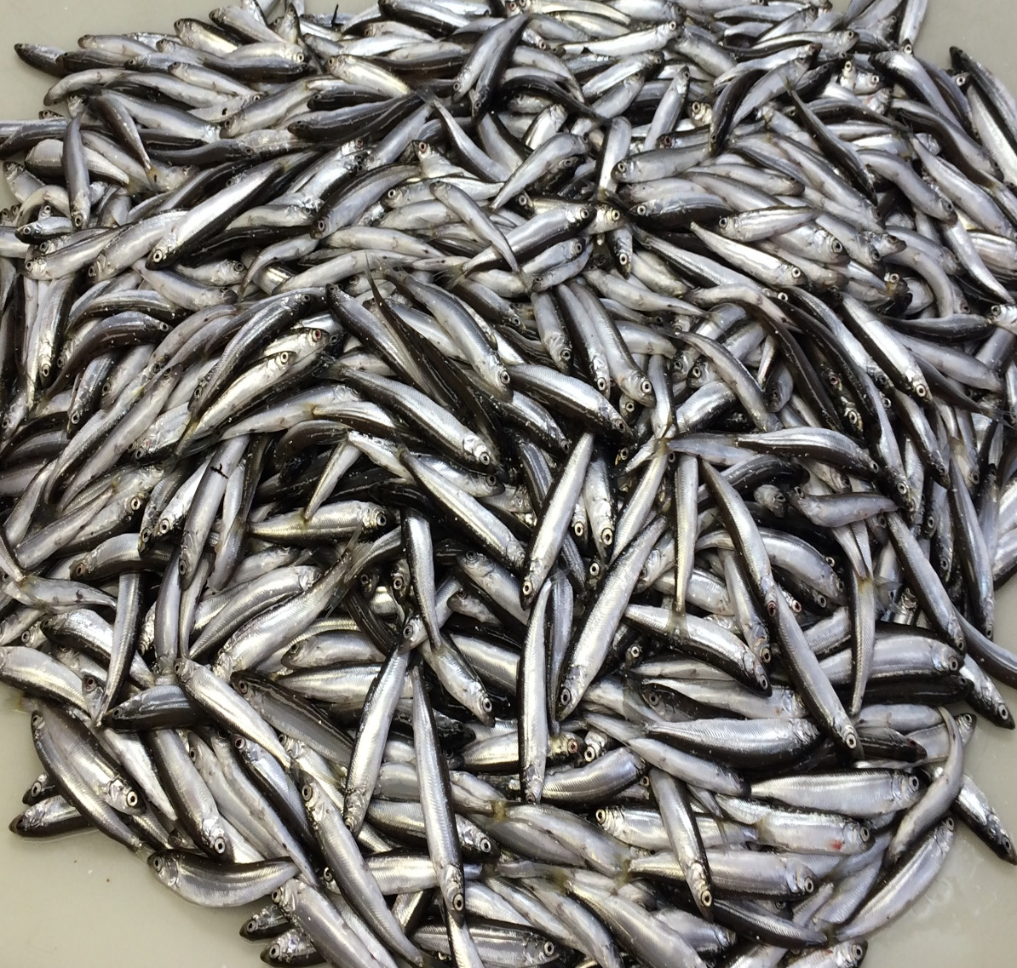
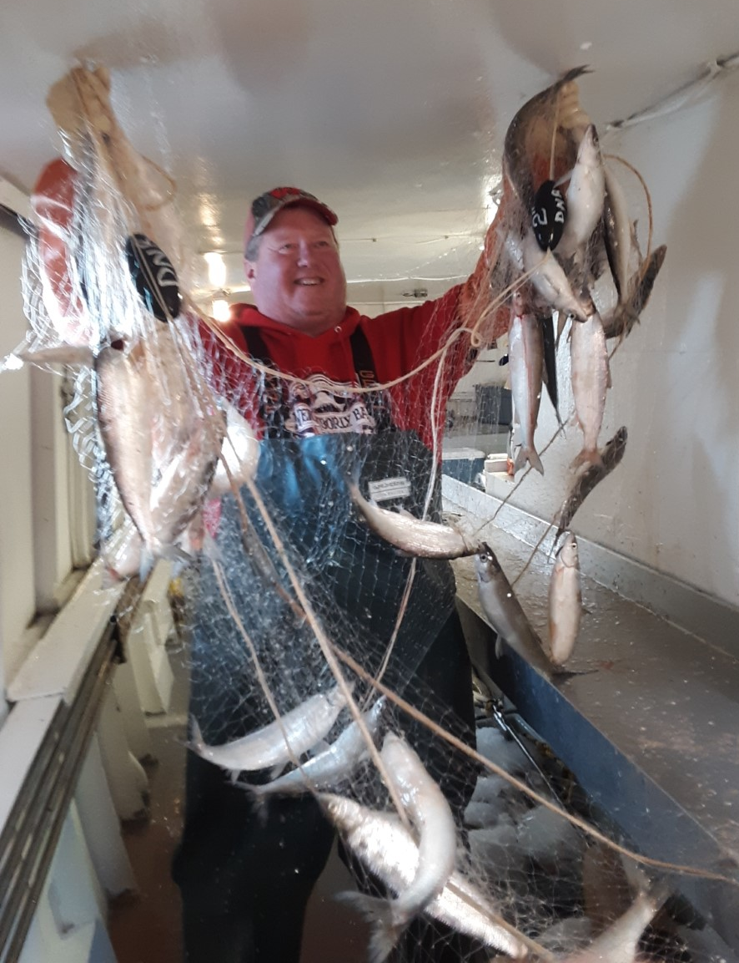
How Many Age-1 Cisco Does It Take
To See A Return To The Fishery?

Slide 15
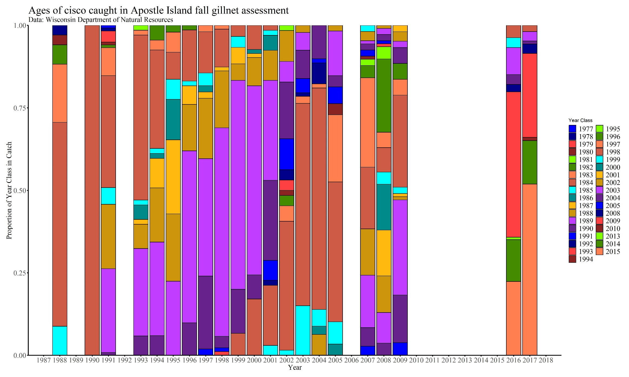
Step 1: Age Composition of the Fishery
17
18
19
13
2003
15
16
2008
12
2009
11
10
2014
9
8
7
6
4
3
2
1
5
2015
1989, 19 years

Slide 16
Step 2: Year Class Contribution To The Fishery

Slide 17
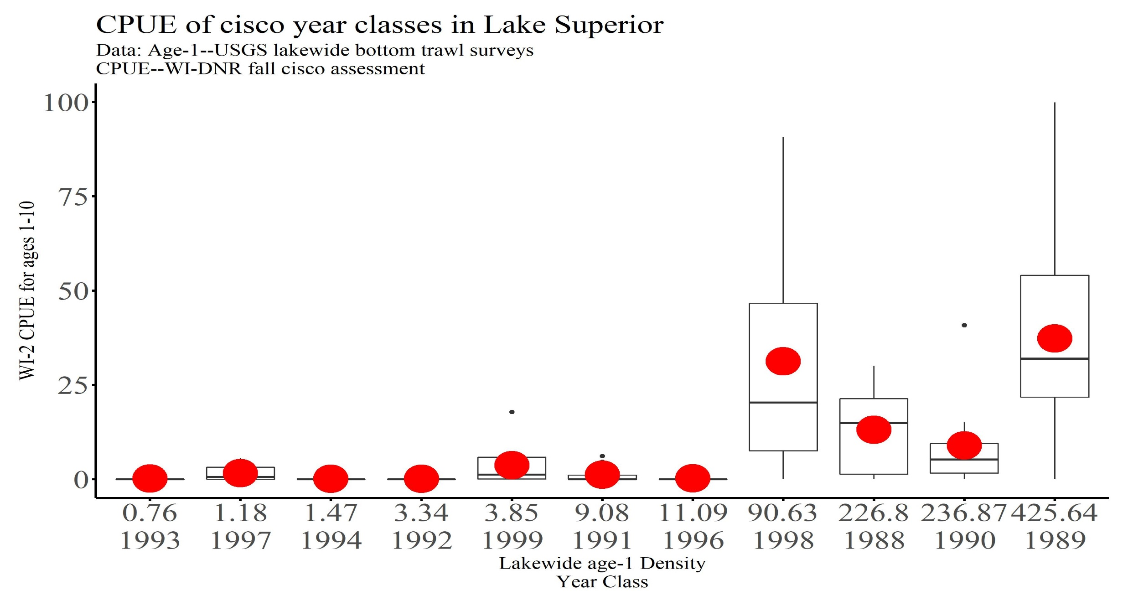
Step 2: Year Class Contribution To The Fishery
>100 age-1 fish per ha
<10 age-1 fish per ha
CPUE = Number of age 1-10 fish per 1200 feet of net per hour

Slide 18
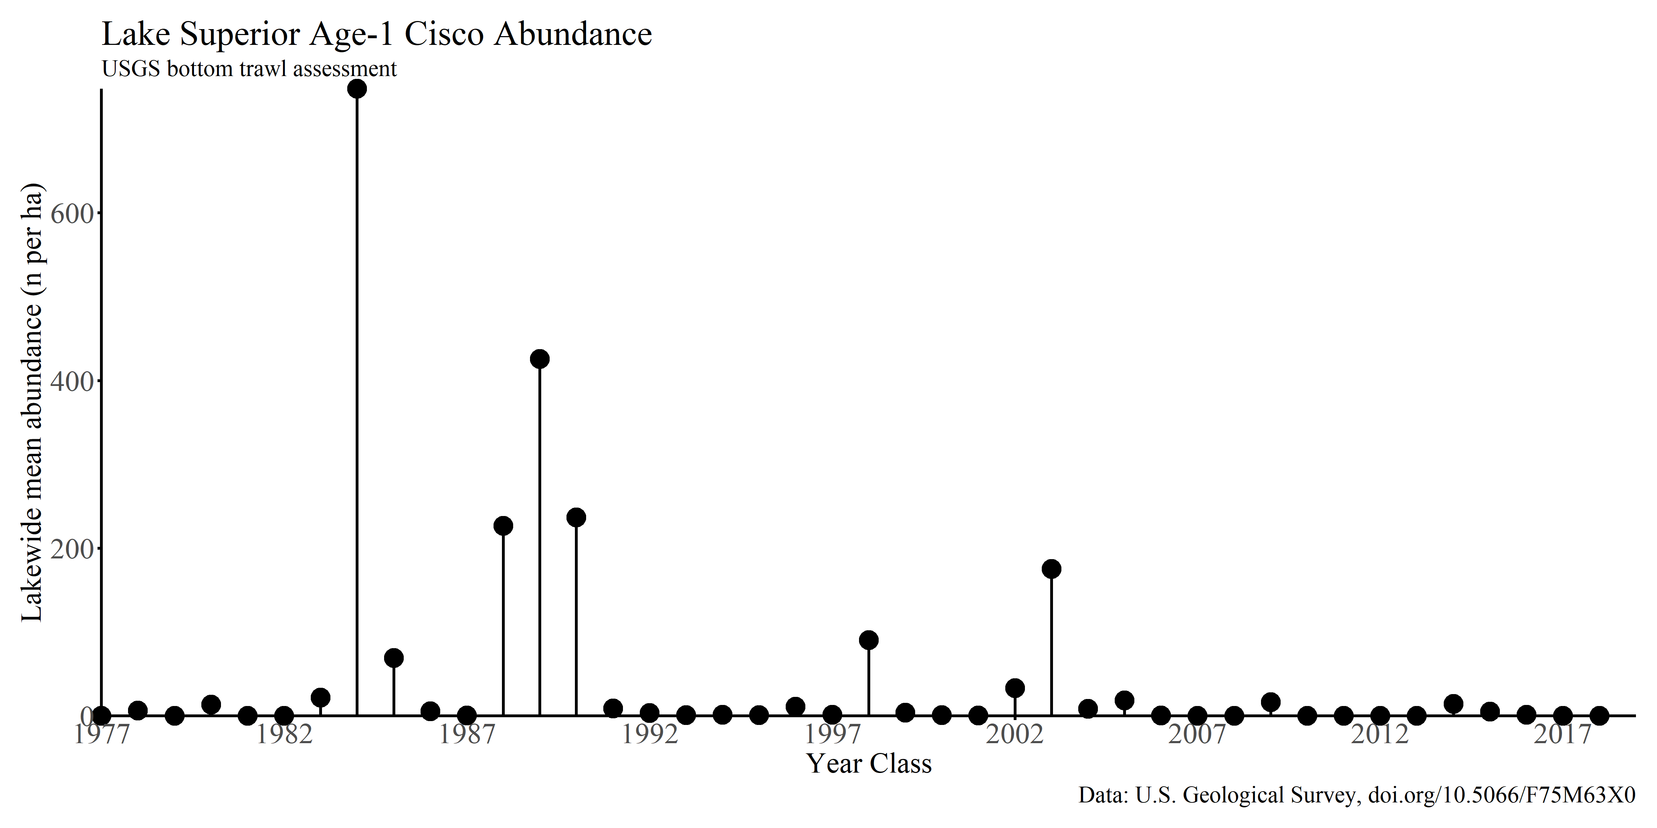
Cisco Year Class Strength
16 years ago
100 fish per ha

